Slide 1

Sentiment Analysis On User Reviews - Yelp
Karan Desai
Kirty Vedula
Rutgers University

Slide 2
Summary of Last Week
User Review Data Set - 330,000
{ User ID, Business ID, Review Text, Star Rating }
Review-to-rating match
Tagging based on parts of speech
Bi gram approach - dividing the sentences into word-sets of two -[ Adverb + adjective ]
Implement 5-scale rating as opposed to binary
Weight of each review is calculated after summing up the sentiments
Normalizing them according to a formula

Slide 3
Information Retrieval and Sentiment Analysis
Bi-Gram Approach - Example
“not good” , “too good”
good by itself - Positive (1 score)
not good - negate the positive sentiment (-1 score)
too good - boost the positive sentiment (1+1= 2 score)
Parts of Speech Tagging
Input :
nltk.word_tokenize("This restaurant is very good .I love it here")
Output :
[('This', 'DT'), ('restaurant', 'NN'), ('is', 'VBZ'), ('very', 'RB'), ('good', 'JJ'), ('.I’, 'NN'), ('love', 'NN'), ('it', 'PRP'), ('here', 'RB')]
What we need :
('very', 'RB'), ('good', 'JJ')
*RB - ADVERB, *JJ - ADJECTIVE

Slide 4
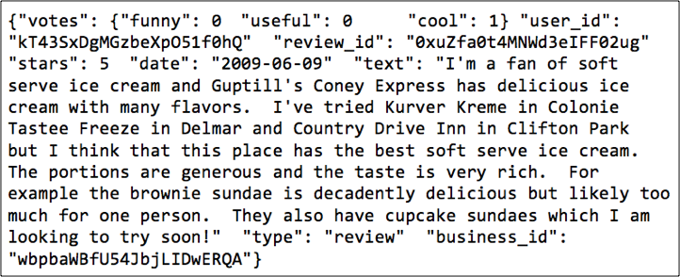
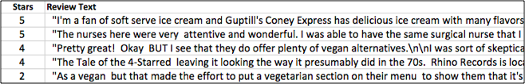
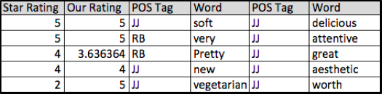
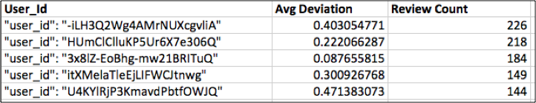
Snapshot of data

Slide 5
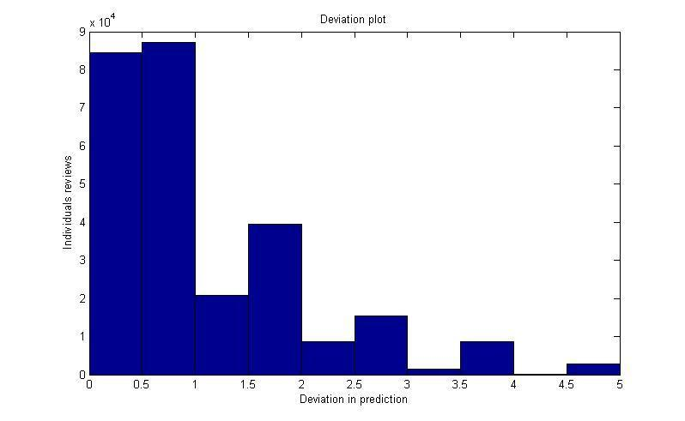
Variation among the reviews - calculated

Slide 6
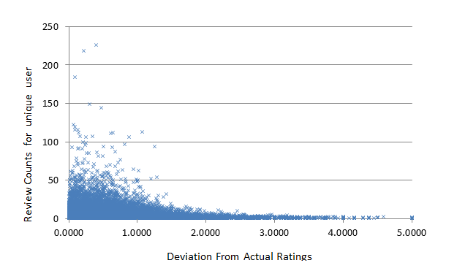
User : Count vs Deviation

Slide 7
Part II : Classification
Supervised learning
Compare the performance with one vs. all validation
Other techniques including k-fold and leave-one-out cross validation are also available.
Labels - users' ratings
Five algorithms - Linear regression, Naïve Bayes, logistic regression, discriminant analysis, SVM
Validation using confusion matrix, ROC, Rate of learning

Slide 8
Supervised learning – classification methods
Partition the data into training set and test set
Training set used to calibrate/train the model parameters
Trained model used to make a prediction on the test set
Predicted values compared with actual data to compute the confusion matrix
Compare the performance with holdout validation – one vs. all
Confusion matrix and accuracy

Slide 9
Flow chart
Calculated weight for each review
Split into training and testing
Training on different classifiers
Testing on different classifiers
Inferences
Results
Cross validation

Slide 10
Results for multiclass classification
Classification Method | Naïve Bayes Classifier | Logistic Regression | Discriminant Analysis | kNN classifier(Euclidean) | Support Vector Machines
Working | Based on estimating P(X|Y), the probability of features X given class Y | Measures the relationship among variables using prior probability scores | Expresses one dependent variable as linear combination of other features | Categorizing query points based on their distance to points | Classifies data by finding the best hyper-plane that separates all data points of one class from those of the other class
Accuracy (random = 20%) | 73.67% | 77.96% | 73.67% | 74.26% | Doesn’t converge
Features | Assumption of independence Degree of class overlapping is small Sensitive to parameter optimization | Analogous to linear regression Discriminative classiﬁer because we can view the distribution | - Very fast compared to other classifiers - Creates an equation which will minimize the possibility of misclassifying cases into their respective groups or categories | Does not require models Compute distances to all training examples Susceptible to noise in the training data Distance measure | - Sensitive to parameter optimization - Will not operate well on non-linearly separable sets

Slide 11
Analysis and inferences
One-vs.-all - solves a separate optimization problem for each class (out of 5) simultaneously
Working on a 1-5 scale – randomness is spread widely (as opposed to binary models)
One classfier outperforms others in one context but fail severely in another
If one class is more likely than the others
Large number of points to capture this distinction – otherwise error
Accuracy inherently limited to the likelihood of the most likely class

Slide 12
Why did SVM fail to converge?
Hard classifiers – no probability involved
Good at binary classification problems
Cannot be easily extended to their multi-class counterparts
Slow to train and complicated to implement
Fail at test instances – given a different data set
Naturally handle large dimensional data

Slide 13
Conclusion & Future Extensions
Conclusion
Our method has a Likert Scale Sentiment Rating compared to binary
Compared to random guessing (20%) we have maximum Probability of 77%
Rating of Users based on their reviews
( A trustworthy online review process)
Future Extensions
Weighted Business Ratings
Better feature selection
Feature elimination – including Principal Component Analysis
Include parallel processing to tackle SVMs

Slide 14
THANK YOU
QUESTIONS ?

